Slide 1



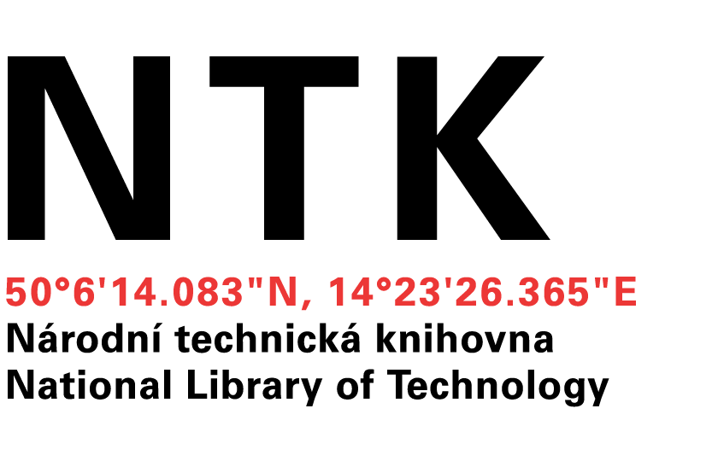
Building cross-field national data repository
Miroslav Šimek
Lukáš Koštenský
Notes:
Míra

Slide 2
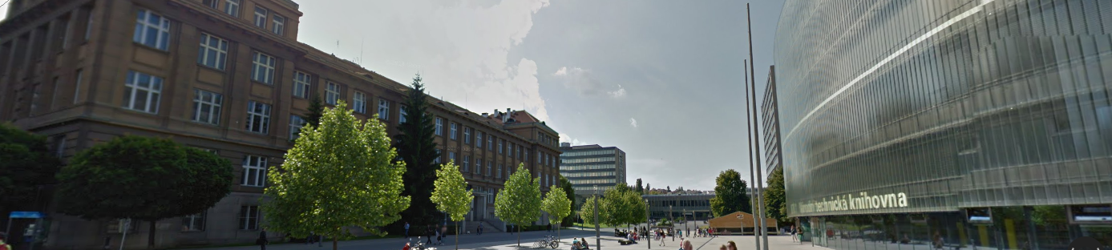
Why NTK and UCT Prague?
Centre for Information Services, UCT Prague
University libraries
UCT publishing house
IT support
Photo: maps.google.com

Slide 3
Why NTK and UCT Prague?
National Library of Technology (NTK)
The largest and the oldest library of science and technology literature in the Czech Republic
Who else should know everything about metadata for scientific data
Photo: maps.google.com

Slide 4
Why NTK and UCT Prague?
In 2013, CIS and NTK joined forces and founded ChemTK, a shared library of chemistry, sharing not only books but also e-sources and people
Department of Organic Chemistry of the Czech Academy of Sciences joined ChemTK in 2015
Photo: maps.google.com

Slide 5
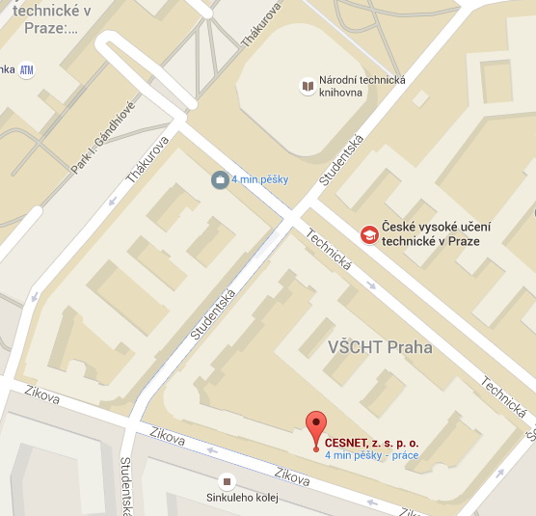
Why CESNET?
An association of universities of the Czech Republic and the Czech Academy of Sciences
Operates and develops the national e-infrastructure for science, research and education
encompasses
computer network
identity management (eduid.cz)
data storage (21PB of space)
collaborative environment
Level of trust
Source: maps.google.com
Photo: maps.google.com

Slide 6
Cross-field repository
Initial group of users – science
Department of Organic Chemistry, UCT Prague
Romany Studies, Faculty of Arts, Charles University
Used as normal document repository
UCT Prague
institutional repository (qualification works, articles, other documents)
media repository
Photo: maps.google.com

Slide 7
Department of Organic Chemistry

Slide 8

Department of Organic Chemistry
Source: uoch.vscht.cz

Slide 9
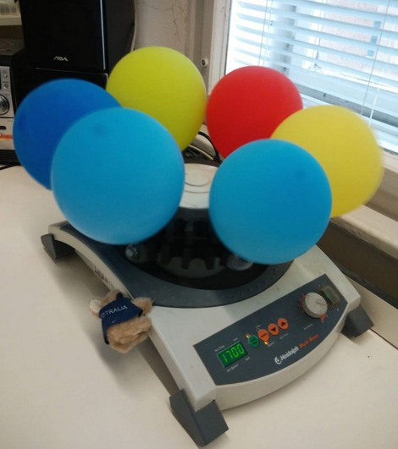
Department of Organic Chemistry
Source: uoch.vscht.cz

Slide 10
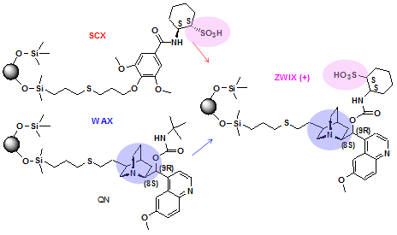
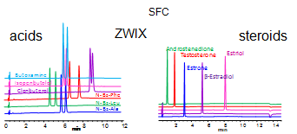
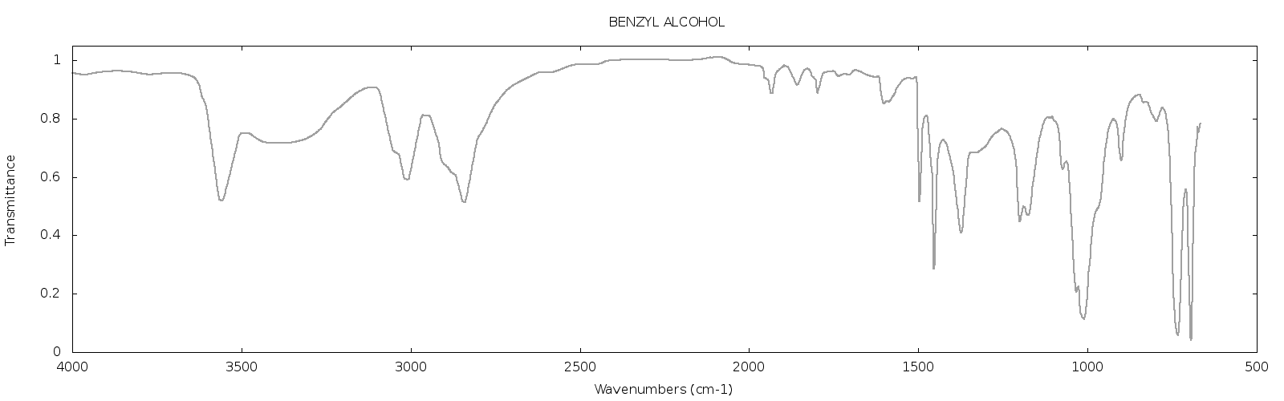
Department of Organic Chemistry
Source: bafa.vscht.cz

Slide 11
Department of Organic Chemistry
Carefully log the source compounds, reactions, reaction conditions and tools used, synthetized products and the data coming from spectroscopic measurements, NMR, chromatography and other analytical methods
Want to
have the data safe, backed-up
make sure that the data are searchable and available for all the team members, regardless of their geographical location

Slide 12
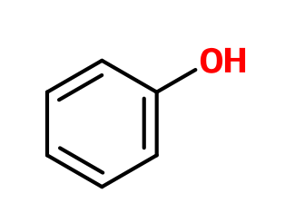
Department of Organic Chemistry
Make sure that the data are searchable
Give me data about chemical compounds with substructure
Give me all data containing a sharp peak in IR spectrum in the region of 2500-3000

Slide 13
Department of Organic Chemistry
Do not want to publish the data at the time of measurement because:
They are writing an article about the reactions/compounds/data (publish or perish)
They want to patent the reactions
They are members of the Laboratory of New Psychotropic Drugs and their results can’t be published in detail at all

Slide 14
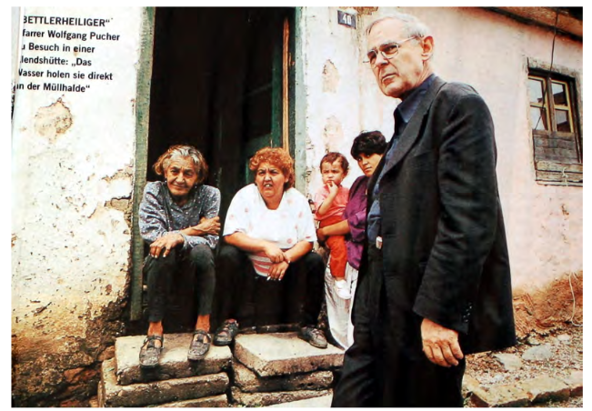
Romany Studies, Faculty of Arts, Charles University
Source: Multi-disciplinary approaches to Romany Studies,
CEU 2007-2009
Notes:
Lukáš
Second group

Slide 15
Romany Studies, Faculty of Arts, Charles University
Need to store recordings of interviews with Roma people from the Czech Republic and Slovakia together with different searchable metadata
Technical (where, when, data format, …)
Personal (who, personal relations, …)
Transcriptions, interview topics, tags, …
Problems:
Both data (recordings) and metadata contain personal information that should not be published beyond the team members
Some parts of the recordings may contain descriptions of activities that could not be disclosed at the moment, should not be available even to the team but might be disclosed later

Slide 16
Romany Studies, Faculty of Arts, Charles University
From the data point of view, one resource (in this case a video recording) should have several manifestations:
Full version, archived but not available to anyone but the author
Version with some of the information stripped/blackened for the team members
Even more stripped version for public use
DTTO for metadata
Highest protection: SSN and other identifiers
Medium protection: date of birth
No protection: age
The sets of data and metadata with a given level of protection changes in time

Slide 17
Comparison
 | Chemists | Romany Studies | Classical libraries
Data formats | Mainly specialized data formats: Molecules, reactions, spectra, other measurements | Mainly annotated multimedia: Videos, metadata about people, personal relations | Classical DCTerms as you know them: Title, Author, Abstract, …
Search | Substructure search, searching by features in graphs, in metadata ann. | Searching in metadata annotations | Searching in metadata annotations
Data amounts | Huge (in case of computational chemistry) | Large | If not storing digitized data, moderate
Security | Very well defined and enforced | Very well defined and enforced, to the level of single metadatum | “Everything should be public, open access is the goal”
Data entry | Do not bother me with that | I know I have to add subtitles | Metadata specialists

Slide 18
The Quest
Data repository containing diverse data and associated metadata and providing customizable UI for searching, viewing and editing the data
Easy to use tools for data filling
For chemistry, automatically send laboratory data to the server, run algorithms on measured data to identify and index search features
For Romany studies, have a mobile application for audio/video capture together with tagging and transcription tools, sending the data directly to the repository
Notes:
Míra

Slide 19
Cross-field repository
Reuse repository backend, do not write our own
Reuse search, do not write our own
Keep the design modular
adding new field should not mean changing the implementation of previous fields
Keep the design open for interdisciplinary data
Let it be in Python
Photo: maps.google.com

Slide 20
Architecture
UI layer based on Django
Data access layer
Repository backend
Search backend
Automatic
tasks
Metadata view
Metadata view
Model definition
Model definition
}
}
HTML
Python

Slide 21
Cross-field repository
Repository backends
DSpace
Invenio
Fedora
Search engines
SOLR
Elastic Search
Photo: maps.google.com
Notes:
Lukáš
Similar performance
Invenio: MARC only
Fedora: clean modulary design
versioning Elastic Search: nested documents
parent-child relationship (You can search parents document which children meet the specified conditions. And oposit way – search children which parents meets specified conditions)

Slide 22
Cross-field repository
Current status
Implemented proof of concept – institutional repository of UCT Prague which is now in production
Implemented proof of concept – repository for Romani studies
Initial steps in OCH data
Waiting for Screenshots?
Photo: maps.google.com

Slide 23
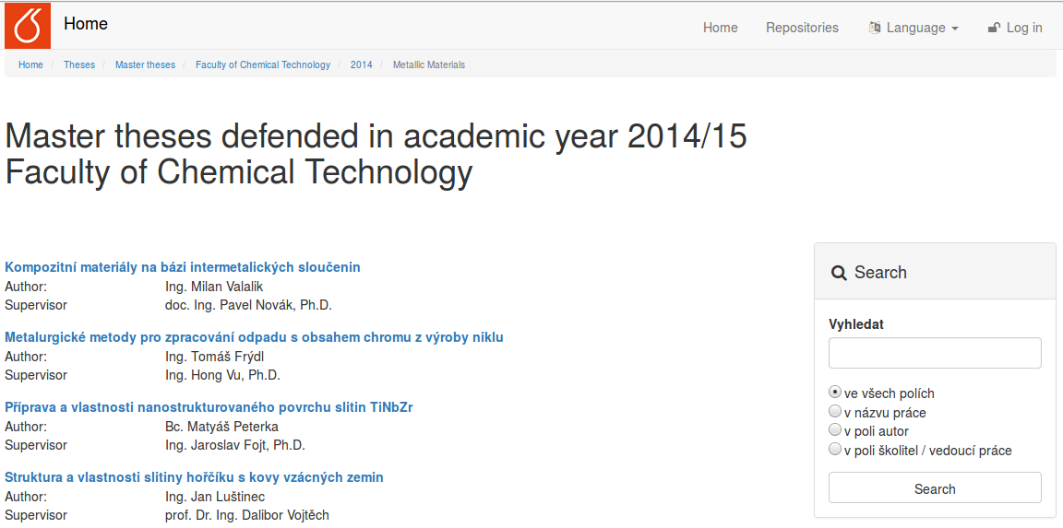
Look and Feel – classical repository
Notes:
Míra

Slide 24
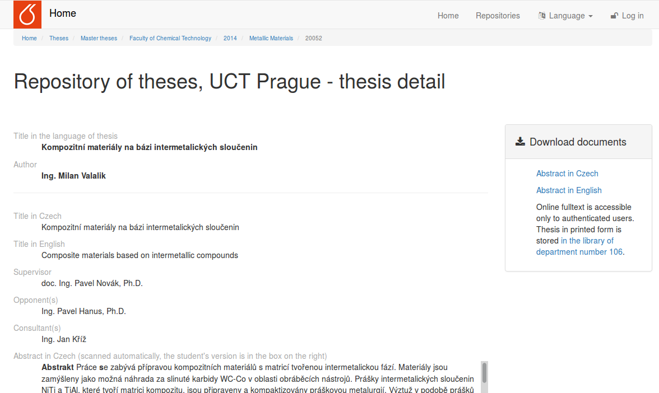
Look and Feel – classical repository

Slide 25
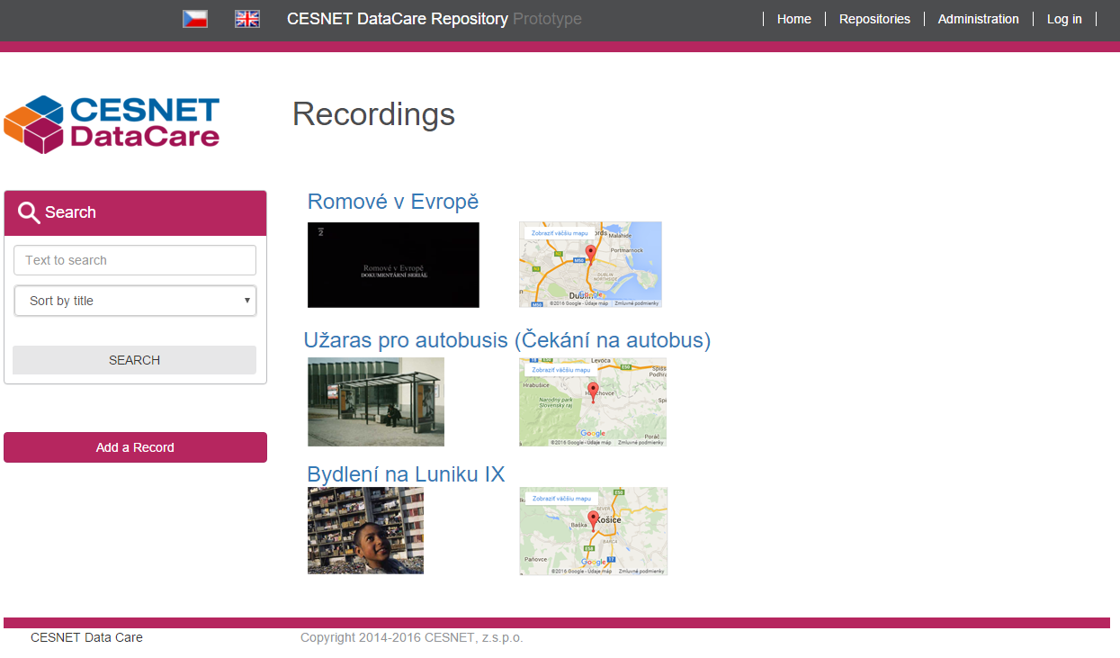
Look and Feel – Romany studies
Notes:
Lukáš

Slide 26
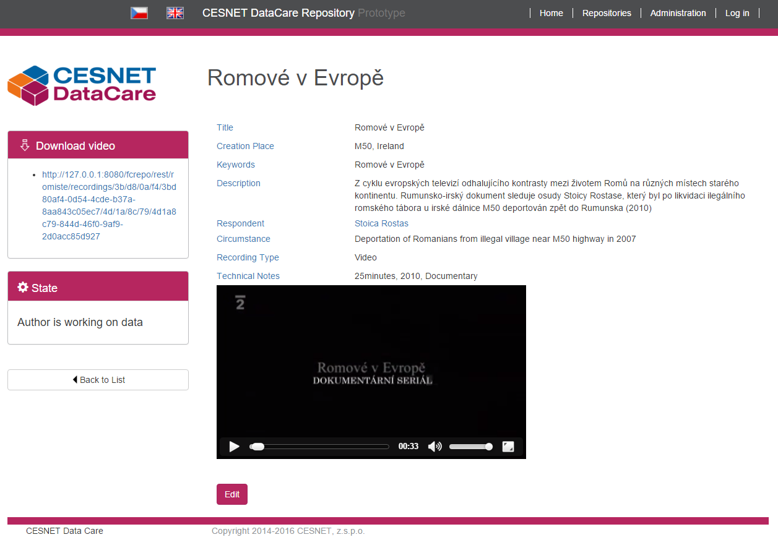
Look and Feel – Romany studies
Notes:
Next slide video

Slide 27

Look and Feel – Romany studies

Slide 28
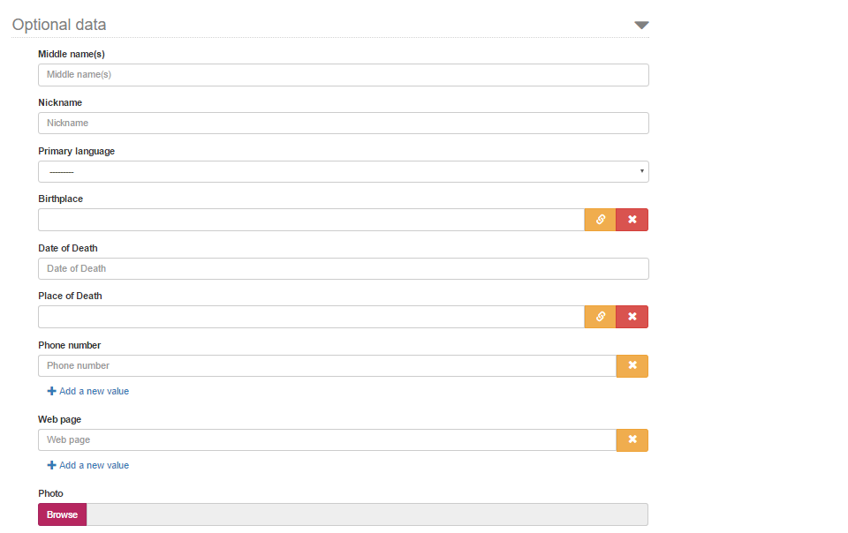
Look and Feel – Romany studies

Slide 29
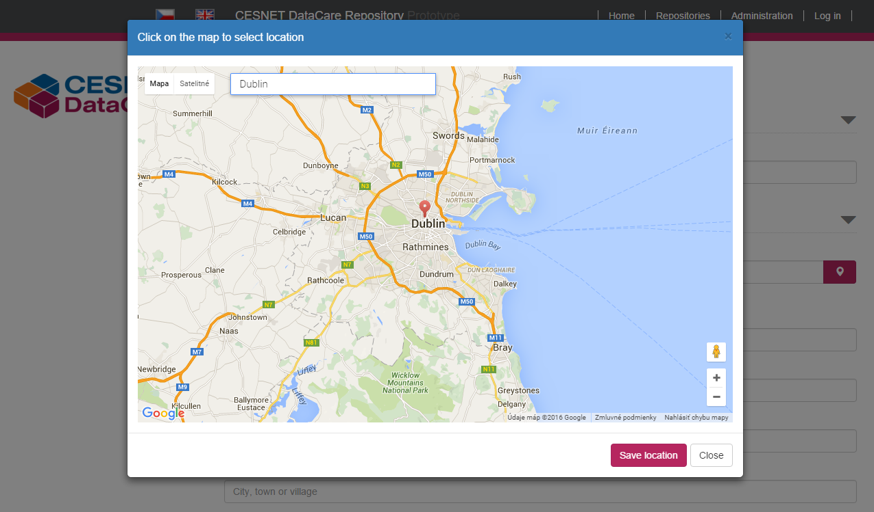
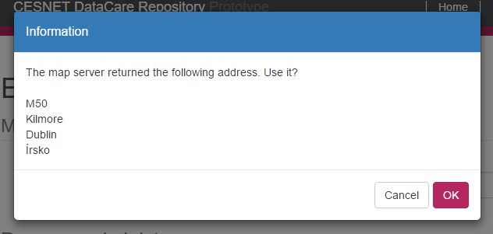
Look and Feel – Romany studies

Slide 30
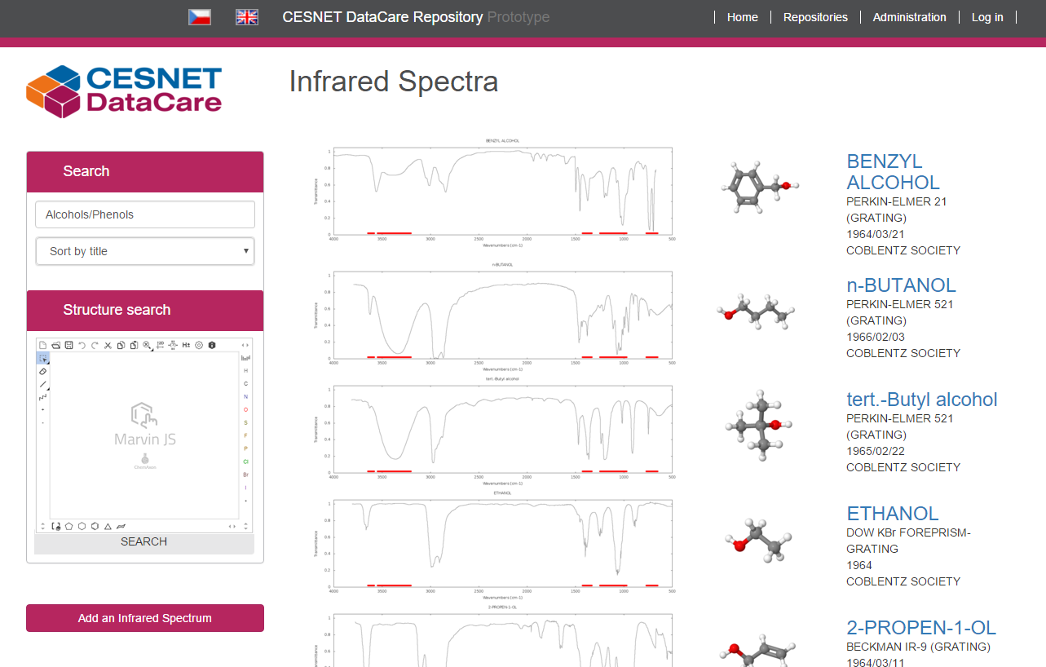
Look and Feel – Spectroscopic data

Slide 31
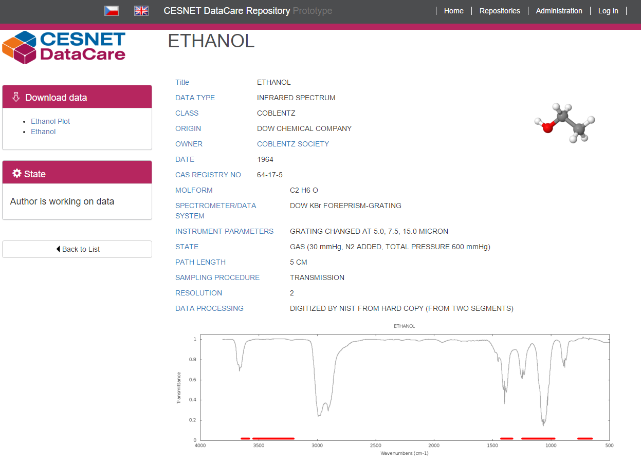
Look and Feel – Spectroscopic data

Slide 32
Architecture II
CESNET DataCare Repository
Custom templates
Built-in templates
Typed API
Untyped API
Fedora
Metadata
Data
WebAC
States
Custom data definition
State engine
Data add-ons
Built-in datatypes
Schema mgmt
Elastic Search
House keeping tasks
Notes:
Míra

Slide 33
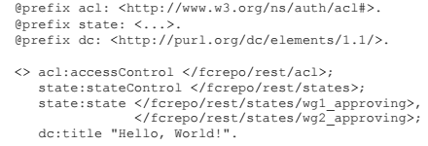
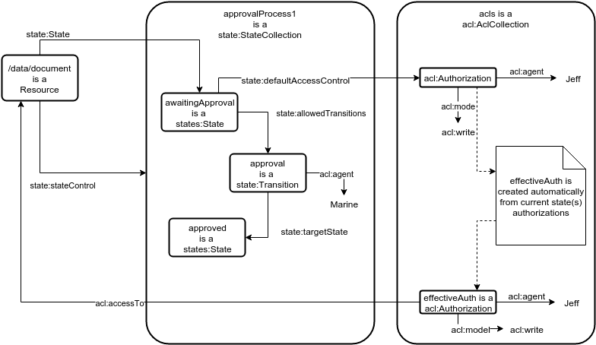
Architecture II - states

Slide 34
Architecture II end of the year
CESNET DataCare Repository
Custom templates
Built-in templates
Typed API
Untyped API
State engine
Field
AC
Fedora
Metadata
Data
WebAC
States
Custom data
definition
Custom templates
Data add-ons
Custom data definition
Data add-ons
Built-in datatypes
Schema mgmt
Elastic Search
House keeping tasks and data conversion

Slide 35
Cross-field repository
This year
Finalize repository for Romani studies
Finalize proof of concept for OCH data
Start working on media repository at UCT Prague and its connection to e-learning and online teaching materials
Following steps
Other fields
Photo: maps.google.com

Slide 36
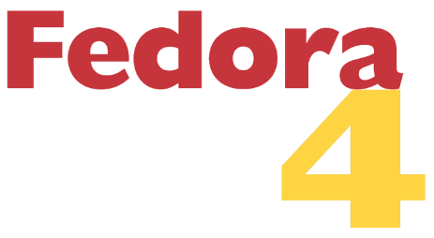




Special thanks to
bleach | inflection | isodate | pyparsing
django-bootstrap-pagination | rdflib | requests | python-dateutil
bootstrap | jquery | bootstrap3-dialogs | Google APIs

